Slide 1
PRESENTATION SLIDES
-ASSIGNMENT -
RMCT RESEARCH PROPOSAL
Name: KAEMON NG BAO LENG
TP No: TP082265
Intake Code: APD2F2506CS(AI)
Lecturer: Dr. Hemalatha Ramalingam
Date: 25/01/2026

Slide 2
TITLE: Public Transport Prediction: Enhancing Operational Efficiency by using Receptance Weighted Key Value (RWKV) based architecture
1. TITLE/PROBLEM STATEMENT
PROBLEM STATEMENT:
Supply demand mismatch (due to dynamic factors)
Quadratic Complexity Bottleneck (O(N²))
Infeasibility for real-time operations (due to resource consumption)

Slide 3
2. RQ and RO(In table)
Research Questions | Research Objectives
1. What are the impact and vulnerability of public transport operations regarding demand prediction? | 1. To examine how public transport operations are affected regarding demand prediction.
2. What are the key limitations of Transformer Encoder in public transport operations? | 2. To investigate the shortcomings of Transformer Encoder in public transport operations.
3. How may RWKV improve prediction accuracy and lower resource consumption for public transport operations? | 3. To propose RWKV for public transport operations to improve prediction accuracy and lower resource consumption.

Slide 4
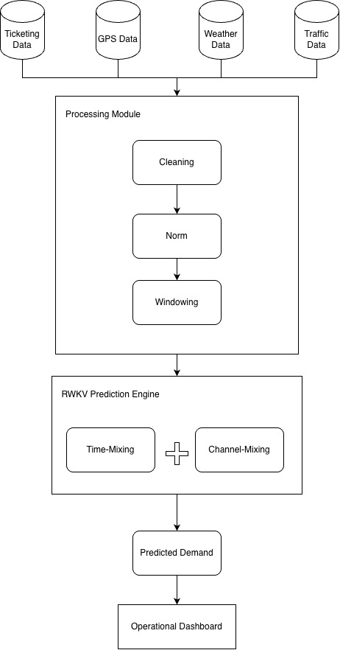
4. PROPOSED SYSTEM

Slide 5
THANK YOU

